Slide 1
We trust in the Community!
Ravikanth chaganti

Slide 2
5
Video operator, did you start the recording?

Slide 3
4

Slide 4
3

Slide 5
2

Slide 6
1

Slide 7
We trust in the community!
Ravikanth Chaganti

Slide 8
In this session …
Learn about
different avenues to learn PowerShell
my favorite and most used PowerShell modules

Slide 9
PowerShell and the Community!

Slide 10
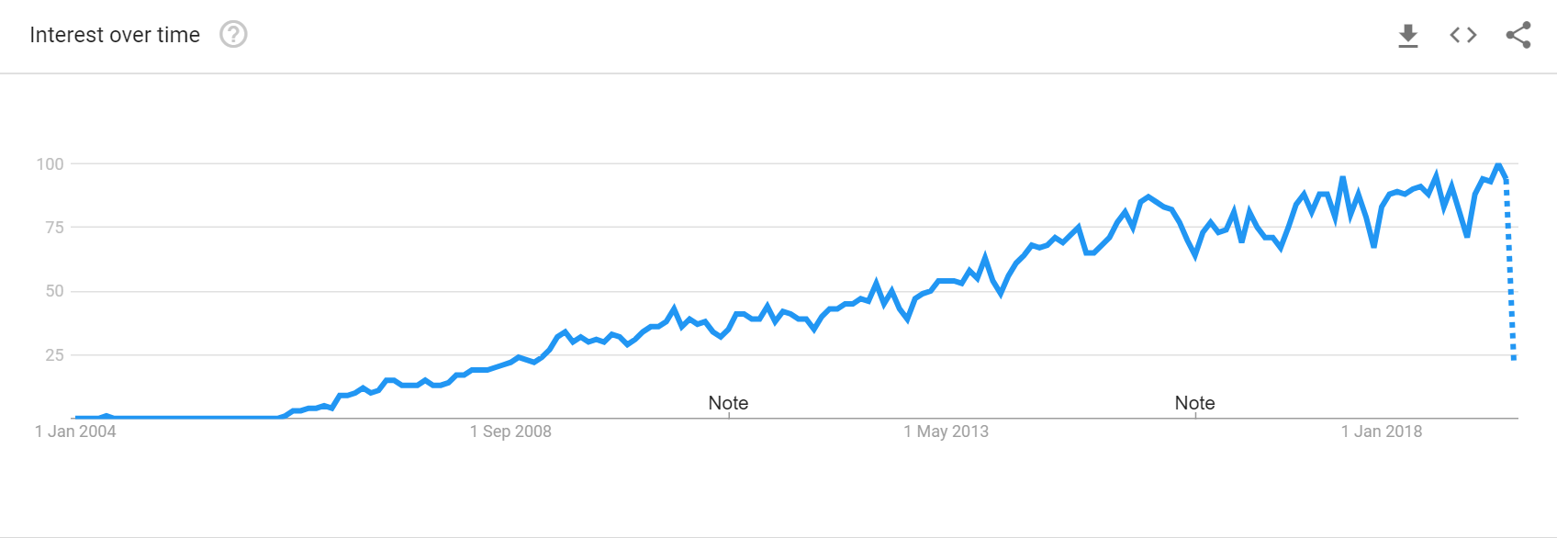
PowerShell Open Sourced

Slide 11
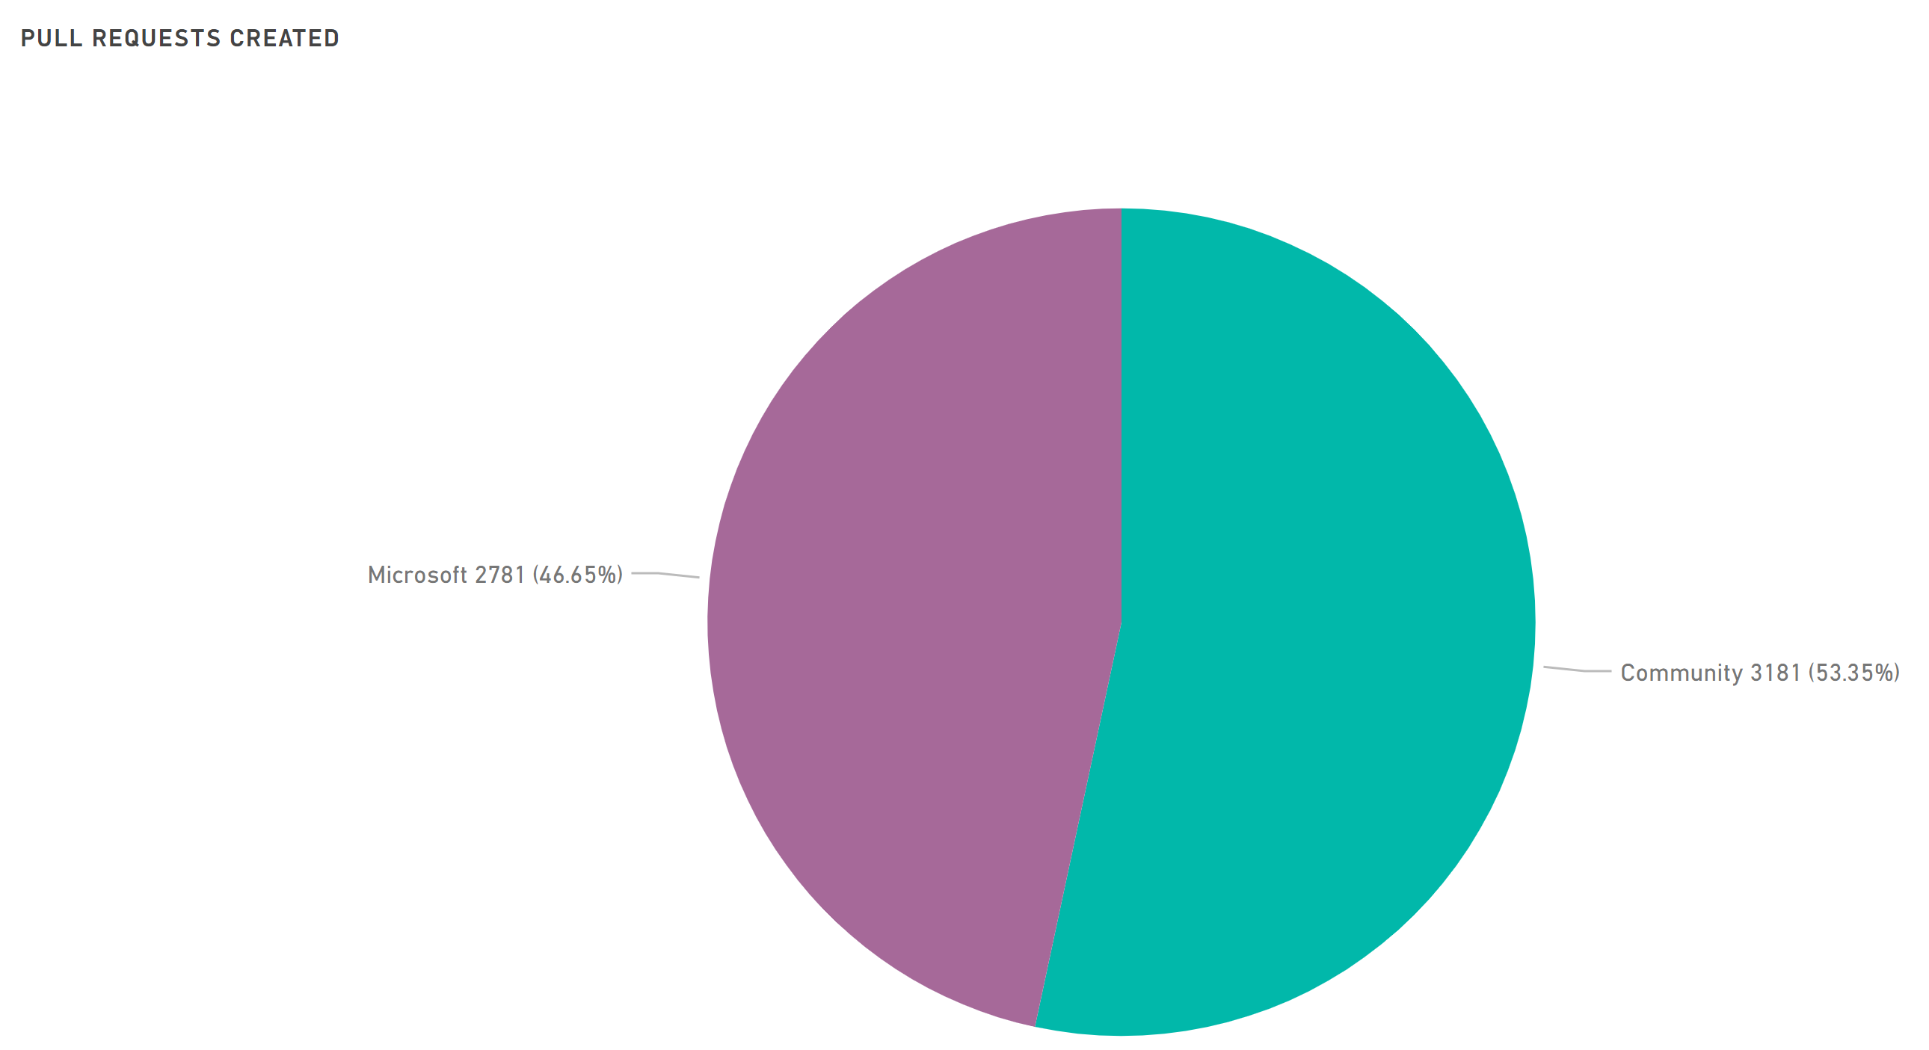
PowerShell Repository
http://aka.ms/PSGitHubBI

Slide 12
Community Avenues
How the community helps you learn?

Slide 13
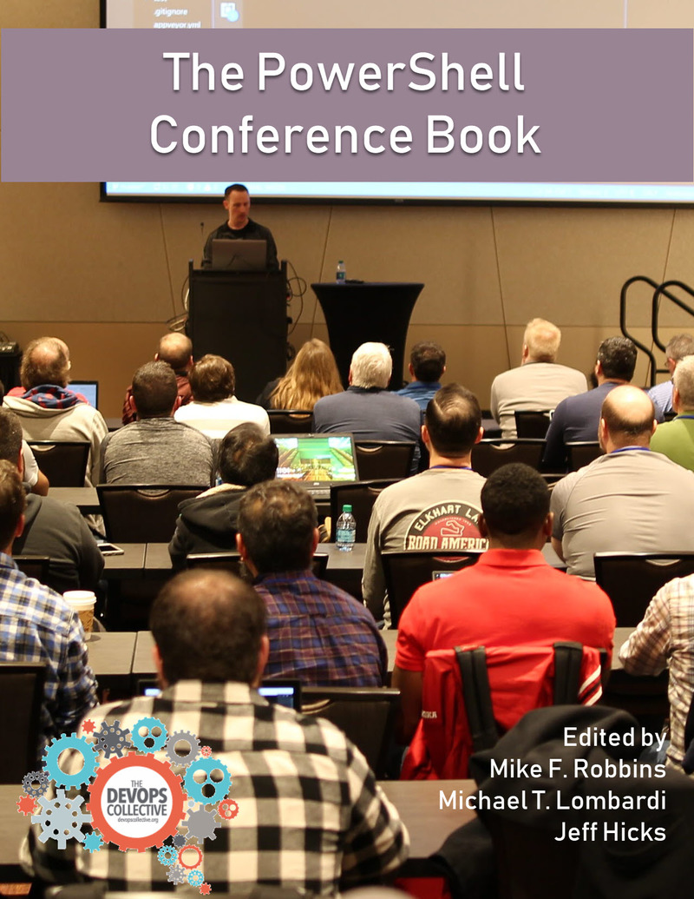
Community Avenues - Books

Slide 14




Community - Blogs

Slide 15





Community – Conferences / User groups

Slide 16
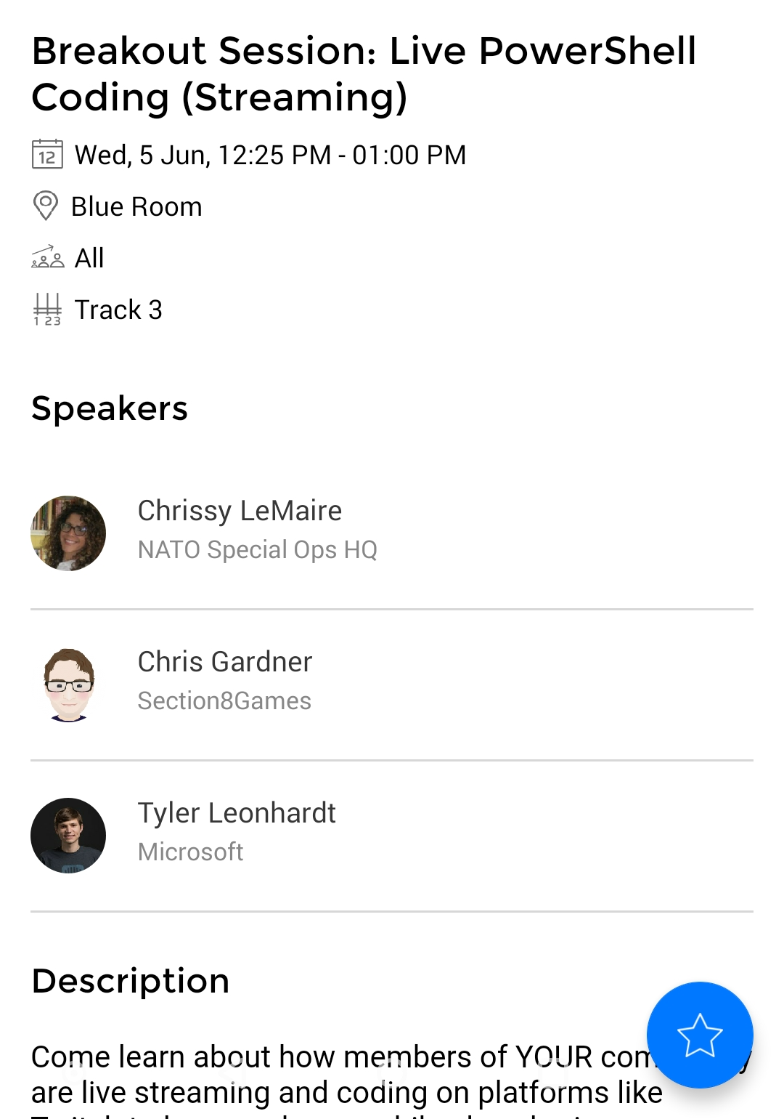
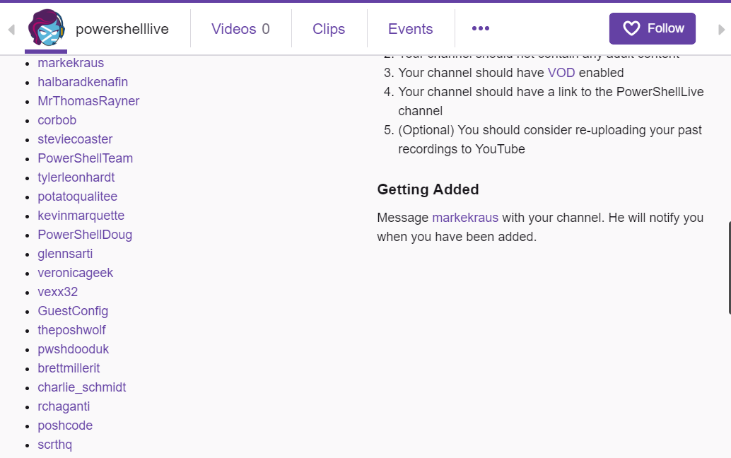
Community – Live Streaming
@PowerShellLive
twitch.tv/PowerShellLive

Slide 17


Community - Forums
Idera PowerShell.com

Slide 18
Community Open Source Modules
4K+ modules in PowerShell Gallery
100s more may be in GitHub repositories!
PESTER DBATOOLS PSFRAMEWORK PSHTML POLARIS AUTOMATEDLAB IMPORTEXCEL POSHRSJOB PSGRAPH DSCRESOURCEKIT PSSCRIPTANALYZER POSH-SSH UNIVERSALDASHBOARD POSHBOT PSAKE PSDEPLOY INVOKEBUILD

Slide 19
PSKoans by Joel Sallow (@vexx32)
https://github.com/vexx32/PSKoans

Slide 20
ImportExcel by Doug Finke (@dfinke)
https://github.com/dfinke/ImportExcel

Slide 21
Polaris by @PowerShellTeam
https://github.com/PowerShell/Polaris
PSHTML by Stéphane van Gulick (@Stephanevg)
https://github.com/Stephanevg/PSHTML

Slide 22
PSGraph by Kevin Marquette
https://github.com/KevinMarquette/PSGraph

Slide 23
UniversalDashboard by Adam Driscoll
https://github.com/ironmansoftware/universal-dashboard

Slide 24
Publish Your Own Module

Slide 25
Get Involved
PowerShell Community calls
https://devblogs.microsoft.com/powershell/regular-cadence-for-powershell-core-community-call/
https://devblogs.microsoft.com/powershell/dsc-resource-kit-community-call/
PowerShell Slack: http://slack.poshcode.org/
PowerShell Reddit: http://www.reddit.com/r/powershell
Twitter: https://twitter.com/search?q=%23PowerShell&src=hash
GitHub: https://github.com/powershell

Slide 26
PowerShell is really about you – the community!
And, YOU have never been more important!

Slide 29
about_Speaker
Distinguished Member Technical Staff at Dell EMC
Multi-year Microsoft MVP (PowerShell)
Published Author
Founder and Editor of PowerShell Magazine
github.com/rchaganti
linkedin.com/in/rchaganti/

